Slide 1
The Christian and idolatry
What is idolatry ?
We would rather be occupied with the Lord Jesus, but the Bible states: “Flee idolatry”. Therefore we must know the danger of idolatry in our days.
Idolatry is worshipping other things besides the one true God.
It is image- worship or divine honour paid to any created object : worshipping creatures in stead of the Creator

Slide 2
The Christian and idolatry
What does God say about idolatry ?
Consistently throughout the Bible it is made very clear that idolatry is unacceptable :
“…. and that you do not inquire after their gods, saying, 'How did these nations serve their gods? I also will do likewise.’ You shall not worship the LORD your God in that way; for every abomination to the LORD which He hates they have done to their gods ..” (Deut. 12:29-32)
“But concerning those of the nations who have believed, we have written, deciding that they should observe no such thing, only to keep themselves both from things offered to idols and from ….” (Acts 21:25)
“Wherefore, my beloved, flee from idolatry” (1Cor. 10:14)
“

Slide 3
The Christian and idolatry
How did idolatry come into being ?
The origin of idolatry is described in Rom. 1:21- 25: men forsook God, and sank into ignorance and moral corruption (1:28).
Romans 1:24 : ”God also gave them up”. Note the repetition of this phrase in verses 26 and 28. Inspired by the Holy Spirit, Paul is attacking the flagrant idolatry of most of the nations, in which animals were considered gods (v. 23), sexual perversion was prevalent (vv. 26- 27), and sin in general was rampant (vv. 29- 32)

Slide 4
The Christian and idolatry
Idolatrous nations in the Bible
“.. the Baals, and the Ashtoreths, and the gods of Syria, and the gods of Zidon, and the gods of Moab, and the gods of the children of Ammon, and the gods of the Philistines ..” (Judges 10:3)
2 Kings 19 speaks of the gods of Gozan, Haran, Rezeph and the people of Eden who were in Tel Assar. 2 Chronicles 25:20 says, “they sought the gods of Edom.”
"You know that when you were of the nations you were led away to dumb idols, in whatever way you might be led” (1 Cor. 12:2)

Slide 5
The Christian and idolatry
Idolatrous nations in the Bible
Asherah, a Canaanite goddess : Ex 34:13-14. Asherah was the wife of El, the chief Canaanite god.
Ashtoreth, a goddess of war and fertility Jdg 2:12-13
Ashtoreth, the wife of Baal, was associated with the evening star
Baal, a Canaanite and Phoenician god of fertility and rain Judgs 2:10-13. Baal, meaning “lord”, was pictured standing on a bull, a popular symbol of fertility and strength.
The worship of these false gods and goddesses included animal sacrifices, male and female prostitution, and sometimes human sacrifices

Slide 6
The Christian and idolatry
Idolatrous nations in the Bible
Baal-Zebub, a popular deity of the Philistines Mt 12:24
Chemosh, the chief god of Moab 1Ki 11:7
Dagon, worshipped in Philistia Judges 16:23
Molech, the chief deity of Ammon 1Ki 11:4-5 See also Lev 18:21. The practice of sacrificing children to Molech was common in Phoenicia and the region; Lev 20:2-5; 1Ki 11:7,33; 2Ki 23:10
Amon, the chief god of Egypt See also Jer 46:25
Tammuz, a Babylonian fertility god Eze 8:14
Bel, the chief deity of Babylon Isa 46:1. Bel was another name for the sun god,
Marduk. Nebo, the god of learning and writing was the son of Marduk. See also Jer 50:2; Jer 51:44

Slide 7
The Christian and idolatry
How did God preserve the knowledge of the living and true God ?
The Old Testament only mentions the names of idols
of nations that had a historical link with Israel. Why ?
Because God took Abraham out and made a nation for Himself : the descendants of Abraham (Gen. 12:1; Josh. 24:3) , Israel, to preserve the knowledge of the living and true God.
"And who is like Your people, like Israel, the one nation on the earth whom God went to redeem for Himself as a people, to make for Himself a name—and to do for Yourself great and awesome deeds for Your land—before Your people whom You redeemed for Yourself from Egypt, the nations, and their gods? For You have made Your people Israel Your very own people forever; and You, Lord, have become their God” (2 Sam. 7:23,24)

Slide 8
The Christian and idolatry
In the Bible Israel is unique among all the nations.
“For you are a holy people to the Lord your God; the Lord your God has chosen you to be a people for Himself, a special treasure above all the peoples on the face of the earth. The Lord did not set His love on you nor choose you because you were more in number than any other people, for you were the least of all peoples; but because the Lord loves you, and because He would keep the oath which He swore to your fathers, the Lord has brought you out with a mighty hand, and redeemed you from the house of bondage, from the hand of Pharaoh king of Egypt”
(Deut. 7 :6-8)

Slide 9
The Christian and idolatry
The God of Israel
The true God distinguishes Himself. He is continually called “the God of Israel”, “the God of Abraham, Isaac and Jacob” in contrast to the gods of the nations.
God calls Himself “The LORD God of your fathers, the God of Abraham, the God of Isaac, and the God of Jacob, has sent me to you” (Exodus 3:15). God is called “the God of Israel” over 700 times. He is NOT called the God of any other nation, (Ps. 33:11-12; Exodus 5:1).
“Then you shall know that I am in the midst of Israel: I am the LORD your God and there is no other” (Joel 2:27).
.

Slide 10
The Christian and idolatry
The responsibility of Israel
The nation of Israel, that came from Abraham, was warned of the idolatry of the nations that came from Noah's lineage that have survived the flood and flourished.
Deuteronomy 12:30: "Be careful not to be ensnared by inquiring about their gods, saying, “How do these nations serve their gods? We will do the same.”
Josh 23:7-9: “and lest you go among these nations, these who remain among you. You shall not make mention of the name of their gods, nor cause anyone to swear by them; you shall not serve them nor bow down to them, "but you shall hold fast to the LORD your God, as you have done to this day.”

Slide 11
The Christian and idolatry
The responsability of Israel
Privileges have corresponding responsibilities :
Through Moses God said to His people/nation Israel:
Deut. 18:9-14: “When you come into the land which the LORD your God is giving you, you shall not learn to follow the abominations of those nations.”
Deut. 28:1-2: “If you diligently obey the voice of the LORD your God, to observe carefully all His commandments which I command you today, that the LORD your God will set you high above all nations of the earth.”
We are told in Judges 2:21-23 that God did not deliver all the nations into the hand of Joshua but left some nations after Joshua died to test Israel. He did this in order to see whether they would keep the ways of the LORD.

Slide 12
The Christian and idolatry
The failure of Israel
Israel was not faithful all the time and was influenced when they intermarried with the other nations.
Judges 3:5-8: “Thus the children of Israel dwelt among the Canaanites, the Hittites, the Amorites, the Perizzites, the Hivites, and the Jebusites. And they took their daughters to be their wives, and gave their daughters to their sons; and they served their gods. So the children of Israel did evil in the sight of the LORD. They forgot the LORD their God, and served the Baals and Asherahs.”
God called it “evil” to serve other gods.
God warned Israel, over and over, NOT to worship Him as the nations do their gods

Slide 13
The Christian and idolatry
The consequences of Israel’s failure
"I will punish her for the days of the Baals to which she burned incense”(Hos. 2:13a)
"days of the Baals”: The whole period of the worship of Baal (the chief Canaanite deity) by Israel. Baal means "lord" or "owner" and was often used as a general term for god. Israel's worship of Baal developed in three stages:
1) placing the Canaanite gods in a secondary place to the LORD
2) considering Yahweh as a super- Baal;
3) Canaanizing or Baalizing Yahweh worship so that the people completely forsook Yahweh
LORD: (Lit., YHWH (probably pronounced "Yahweh"), the most significant name for God in the OT. It has a twofold meaning:
the active, self- existent One (since the word is connected with the verb meaning "to be," Ex. 3:14); and
Israel's Redeemer (Ex. 6:6). The name occurs 6,823 times in the OT and is especially associated with God's holiness (Lev. 11:44- 45), His hatred of sin (Gen. 6:3- 7), and His gracious provision of redemption (Isa. 53:1, 5, 6, 10)

Slide 14
The Christian and idolatry
God is ‘jealous’ with regard to idoaltry. What does it mean ?
"But you shall destroy their altars, break their sacred pillars, and cut down their wooden images, for you shall worship no other god, for the Lord, whose name is Jealous, is a jealous God” (Ex. 34:13,14)
In no single passage is God described as envious. Even in those texts where the adjective “jealous” is used, it is more appropriate to understand it as “zealous.” When God is the subject of the verb qana‘ (= ' to make jealous' in Hebrew), the meaning is “be zealous,” and the preposition le (“to, for”) is used before the object: His holy name (Ezek. 39:25); His land (Joel 2:18); and His inheritance (Zech. 1:14). Cf. Zech. 8:2: “This is what the Lord Almighty says :I am very jealous for Zion….”

Slide 15
The Christian and idolatry
The jealousy of God
God is ‘jeaolous’ of :
His people "of whom, as according to flesh, is the Christ, who is over all, God blessed for ever”(Rom. 9:5)
His land (Lev. 25:23), where His beloved Son will be born and will walk around
His holy city, Jerusalem, ("And they shall call you The City of the Lord, Zion of the Holy One of Israel”; Is. 60:14b) where His Son will rule as King of Kings for 1000 years
God can not allow uncleanness, caused by idolatry, in that which belongs to Him and His beloved Son, our Saviour and Lord Jesus Christ.

Slide 16
The Christian and idolatry
What about nations that did not have any relationship with Israel ?
Nations and their cultures that had long departed from the true and living God in Noah's day sank into idolatry (Rom. 1) :
The forms of idolatry are :
(1) Fetishism, or the worship of trees, rivers, hills, stones, etc.
(2) Nature worship, the worship of the sun, moon, and stars, as the supposed powers of nature.
(3) Hero worship, the worship of deceased ancestors, or of heroes.
“….. preaching to you to turn from these vanities to the living God, who made the heaven, and the earth, and the sea, and all things in them; who in the past generations suffered all the nations to go in their own ways” (Acts 14: 15,16).

Slide 17
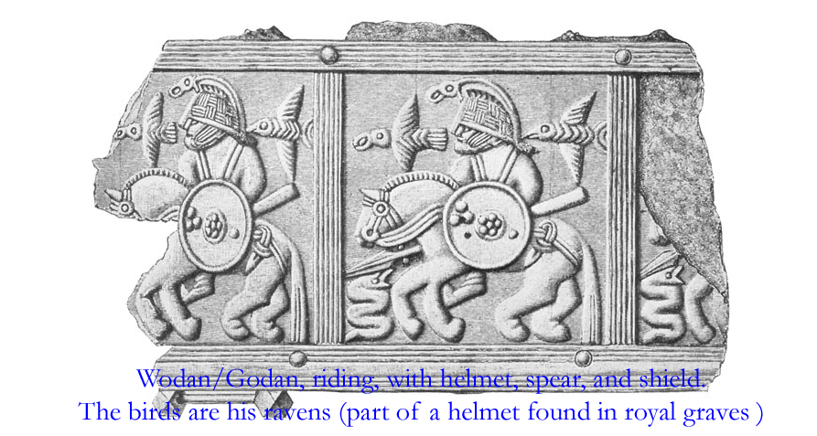
The Christian and idolatry
Idolatrous tribes that went “in their own ways” in Western Europe
Wodan, an ancient Germanic sky god, was known as Woden or Wotan to the Saxons. Wodan was also the god of war and became an increasingly popular Germanic god. Wodan was the husband of the goddess Frija . The tribe of the Lombards called him Godan, the husband of Frea.
Wodan was death and blood sacrifice, the various tribes carrying out sacrificial rite, by stabbing and burning their victims.
Godan was shortened to God
over time and was adopted
by the Germanic tribes as the
name for God after
conversion to Christianity.
Godan/God does NOT have the
features of the God of the Bible.

Slide 18
The Christian and idolatry
The Bible is our only source to get a right notion of God (His nature, His attributes)
The first Christians in Europe from the fourth century on had to learn it when they repented from their idols to the true and living GOD
The earliest uses of the word God in Germanic writing is in the Gothic Bible, translated by Ulfilas into the language of Gothic tribes in the fourth century. The words guda and guþ were used for God in the Gothic Bible.
The translation for the word deus of the Latin Bible was influenced by the then current usage by the tribes for their highest deity, namely Wodan by Angles, Saxons, and Franks of north-central and western Europe, and Godan by the Lombards of south-central Europe around Rome. There are many instances where the name Godan and Wodan are contracted to God and Wod.
They used the same name, but this highest deity does NOT have the features of the God of the Bible.
Let us be careful :
(Job 42:7 : “for you have not spoken of Me what is right”)

Slide 19
The Christian and idolatry
Idolatrous tribes that went “in their own ways” in North America (Native Americans or Indians)
They interacted with the supreme deity, Gitchi-Manitou by way of personal spirits called manitous. From youth, women and particularly men were instructed to seclude themselves, fast, and try to contact a manitou in a dream. Once contacted, a manitou became the individual's guardian spirit, giving the person power (hunting, fishing, and warfare) in return for respect and sacrifices.
At times human life was sacrificed to a Manitou. Sometimes a manitou was offended, they believed, because prisoners were not tortured cruelly enough. Some of the missionaries were tortured under such circumstances. Many of them- like the Jesuits - equated Gitchi-Manitou with the God of the Bible, translating God as Gitche Manitou in scriptures and prayers in the native languages
BUT: the Gitche Manitou they worshipped before their repentance, does not have the features of the God of the Bible.
They need the Bible to get knowledge of the true and living God, regardless the name they use for Him.

Slide 20
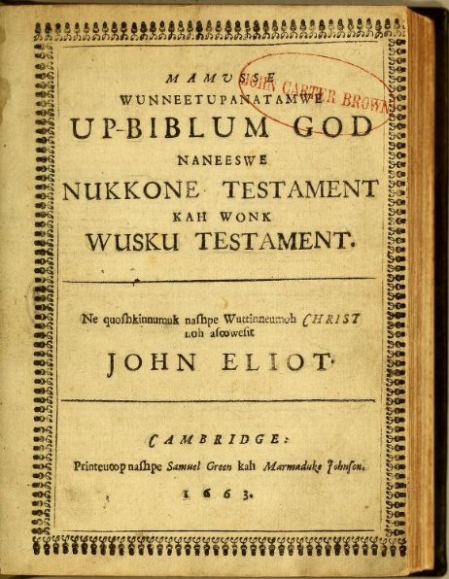
The Christian and idolatry
The importance of the Bible, God’s Word
Translation of the Bible in Massachusett,
the language of local Indians in present Massachusetts :
Translation of the title :
The Whole Holy His-Bible God, both
Old Testament and also New Testament.
This turned by the-servant-of-Christ,
who is called John Eliot in 1663
John Eliot (1604-1690) was the only
missionary to make a new alphabet from
an unwritten language for purposes of
teaching Scriptures, in over a thousand
years since Ulfilas constructed the
Gothic alphabet in the 4th century.
He used the English word God.
The adoption of the orthography of the Bible led to widespread literacy amongst the Indians of New England.

Slide 21
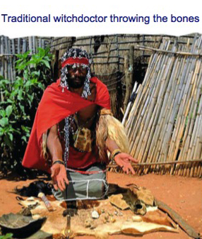
The Christian and idolatry
Idolatrous tribes that went “in their own ways” in Africa
All Bantus traditionally believe in a supreme Being. They do not worship him or her directly as they do not feel worthy enough. They therefore ask the ancestors to communicate on their behalf. maintain a spiritual connection with their living relatives. The Supreme Being is called upon in times of great hardship and need. He is associated with the Sun, or the oldest of alll ancestors. Most names of this highest deity include the Bantu particle ng (nk), that is related to the sky like Mungu (Swahili), Mulungu (Yao a.o.), Unkulunkulu and Umveliqange (Zulu).
There are spiritual leaders, kinds of priests in most
traditional African religions. This person is essential in
the spiritual and religious survival of the community.
In the Zulu culture there are called sangomas that are
responsible for healing and 'divining' - a kind of fortune
telling and counseling. These traditional healers have to
be called by ancestors. They undergo strict training and
learn many skills, including how to use herbs for healing
and other, more mystical skills, like the finding of a
hidden object without knowing where it.

Slide 22
The Christian and idolatry
The deities of these religions do NOT have the features of the God of the Bible.
During a Bible Conference in Uganda in 2013 we studied three questions : “Who is God?”, “Who is man?”, and “Who is the Lord Jesus”? We went rather deeply into the meaning of the name that is used for “God” in African languages in their Bible translation. This name mostly indicates a supreme being whom they consider as creator, but not with whom man can have a direct relationship. This “creator” does not have the features of the God of the Bible. Therefore, it was important to gather together which notions existed (and still exist) with respect to the name they use for “God” today. The contributions of local brothers were important to make it very clear that this “creator,” whose name they use for God, is not at all the same. On the contrary, there is a clear relationship between this “creator” and the belief in the unseen world, where the relationship with the unseen world goes via ancestral spirits. Men have to reckon with these spirits, believing that there are good and evil spirits. It was very comforting for all of us to answer the question, “Who is God?” from the Bible!

Slide 23
The Christian and idolatry
Differences between Christian Faith/Bible and Traditional African religions
- God
Most practitioners of African Traditional Religion (ATR) have an understanding of a creator God, but the teachings of the Bible provide a correct understanding of His nature and attributes when one becomes a Christian.
In ATR the creator is distant from man.
In the Bible God estabished a close relationship with Israel and today
reaches down to draw sinners to repentance to Him and faith in his Son.
- Eternal Rest of the Soul
Many forms of ATR teach that the spirits of the dead can be born back into the realm of the living.
The Biblical teaching is that human have one life on earth, then a single judgment, and then everlasting rest or punishment.

Slide 24
The Christian and idolatry
Indwelling of the Holy Spirit of God
There are many forms of spirits in ATR some can possess the living. In ATR when a spirit possesses a person there are negative consequences and one can be possessed in order to gain some privileged knowledge.
The Biblical Teaching promises that the Holy Spirit of God dwells in the body of the believer The possession of the Holy Spirit of God is both the sign of being “sons of God” and the source of power and comfort .
Christianity is for All Ethnic Groups
ATR are specific to each ethnic group on the continent. No ethnic group is motivated to teach another ethnic group its forms of religion and convert them.
The Bible (the gospel of the grace of God) l) calls people to repentance and faith and out of the nations into the worldwide Church/Assembly.
Christ is the Mediator between men and God
In ATR ancestral spirits, and lesser gods, are usually the spirits that communicate with humans on earth. These spirit do not carry the desires of humans to the Creator God.
Christ Jesus, God’s own Son, takes the “groaning” of believers to God the Father.
Christ was tempted in all the ways men were tempted, so He is the High Priest
who can sympathize with the weaknesses of those who believe in Him.

Slide 25
The Christian and idolatry
Definition of Sin
Sin in ATR is mostly concerned with transgression of morals or community norms. In ATR there is a difference in the severity or degree of a sins. If one does harm to someone in his own ethnic group, it a more serious sin than if one commits it against someone of another group.
In the Bible sin is against and in rebellion to God. All sins are equal.
Forgiveness
Sacrifices are offered in ATR in order appease, or ask favors of the spirits. They are often offered when a wrong is committed.
The will of God, revealed in the Bible, is that all people who repent to Him and believe in His Son, be forgiven and saved through the sacrifice of His Son.
FALSE STATEMENTS :
”Missionaries proclaimed the name of Jesus Christ in Africa 200 years ago. But they used the names of the God who was and is already known by African peoples -- such as Mungu, Mulungu, Unkulunkulu and thousands more. These were not empty names. They were names of one and the same God, the creator of the world, the father of our Lord Jesus Christ.”
The God described in the Bible is none other than the God who is already known in the framework of our traditional African religiosity

Slide 26
The Christian and idolatry
The Bible’s history
It is to be our only source of revelation in knowing and understanding God and His salvation throughout history. Israel was the only nation God took for His own and He warned them about the other nations influencing them in their customs and worship.
But Israel failed : They forgot the LORD their God, and served the Baals and Asherahs. God called it “evil” to serve other gods. God warned Israel, over and over, NOT to worship Him as the nations do their gods. It does not make sense to believe God left redeemable qualities in the cultures of other nations or tribes (world wide) if the Bible says clearly the opposite.
Not one time in the Bible do you find God approving of a nation worshipping and obeying Him, except for Israel, whom he gave the instructions to. The Bible teaches that Israel is unique among the nations and their God is not the same.
What people need to hear is the plain and simple Gospel message of God's proof of His love for them by sending His Son to pay for the penalty of their sins.

Slide 27
The Christian and idolatry
Modern day Idolatry
Idolatry is worshipping other things besides the one true God. Consistently throughout the Bible it is made very clear that idolatry is unacceptable.
1) Pagan religions of the modern age
There are some modern day religions with tens of millions of worshippers which base their religion around idol worship - they worship god’s made out of wood and stone.
2) Idols are anything that will take away our devotion to God.
3) Greed is idolatry according to the Bible.
Put to death, therefore, whatever belongs to your earthly nature: sexual immorality, impurity, lust, evil desires and greed, which is idolatry. Because of these, the wrath of God is coming. Coloss. 3:5-6
So in the future, if we want to avoid idolatry, what do we need to do?
Finally, brothers, whatever is true, whatever is noble, whatever is right, whatever is pure, whatever is lovely, whatever is admirable—if anything is excellent or praiseworthy—think about such things. Whatever you have learned or received or heard from me, or seen in me—put it into practice. And the God of peace will be with you. Philippians 4:8-9. We need to put God and the Lord Jesus first.
-----------

